Slide 1

How to Think in Code
Workshop Lead: Thomas Zheng
Date: June 25th, 2025
Some material adapted from: Larisa Morales Soto

Slide 2

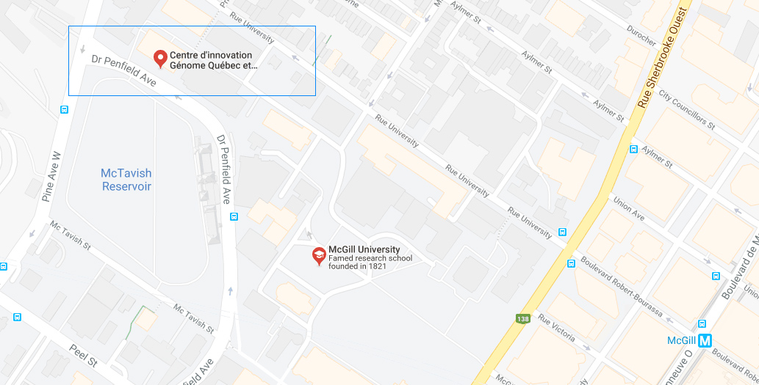
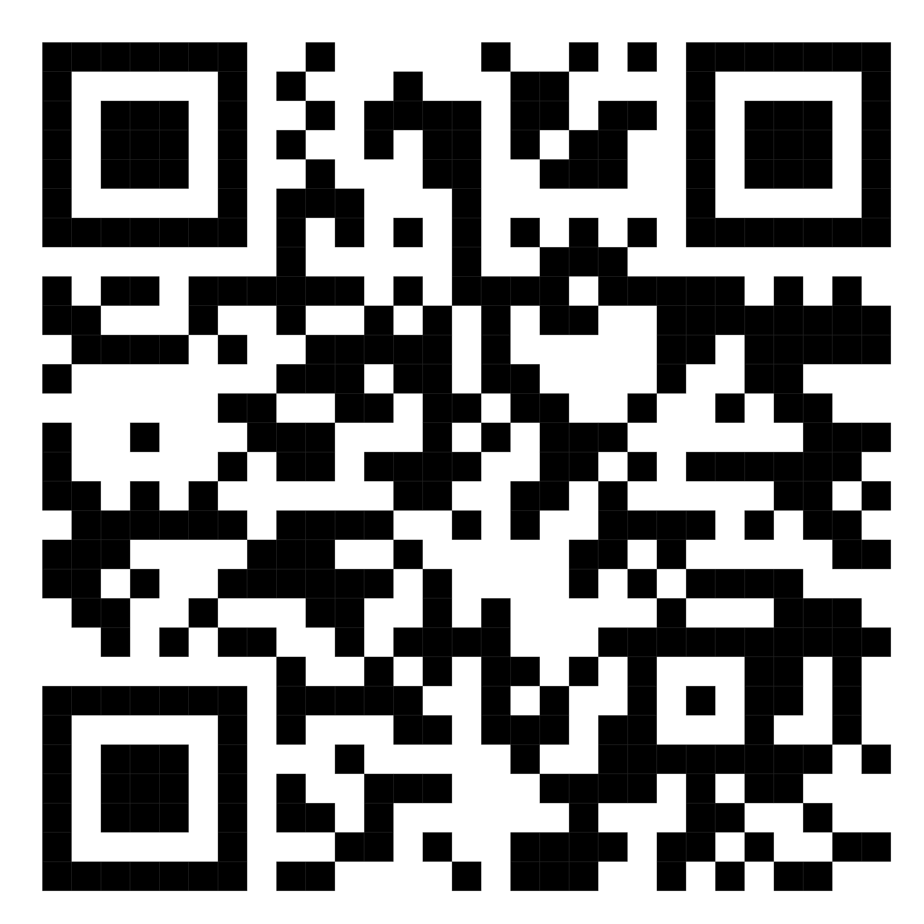
Mission statement: deliver quality workshops designed to help biomedical researchers develop the skills they need to succeed.
Location: 740 Dr. Penfield Avenue, Montreal, Quebec
Scan the QR code to sign up
for our mailing list
Contact: workshop-micm@mcgill.ca

Slide 3
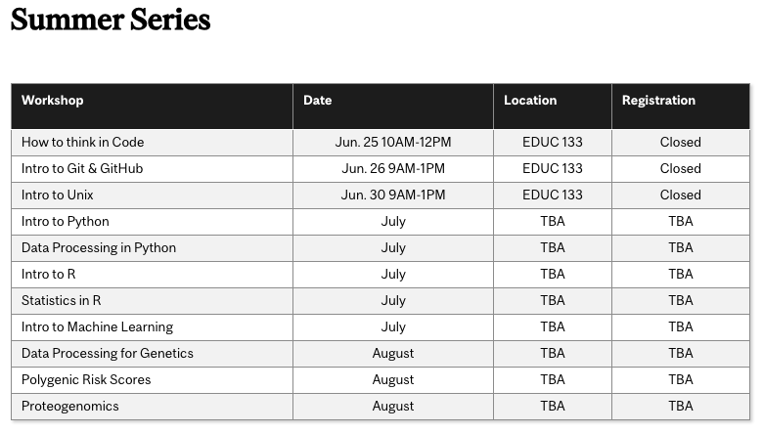
https://www.mcgill.ca/micm/training/workshops-series

Slide 4
What to expect today
Practice structured thinking
Become familiar with programming logic
Learn about basic programming components (variables, algorithms, data structures)
Learn control structures (loops, conditional statements, and more)
We will NOT:
Perform data analysis
Learn about machine learning
Write programs that generate visualizations

Slide 5

Contents
Part 1- What is a computer and a program?
The structure of a computer
Instructions
Recognizing patterns
Pseudocode – control structures
Algorithms
Part 2 – Coding fundamentals
For loops
Boolean logic
Conditional statements
Variables
Data structures
While loops
Programming languages
Exercises:
Create an account
https://brilliant.org

Slide 6
Part 1 What is a Computer and what are Programs?

Slide 7
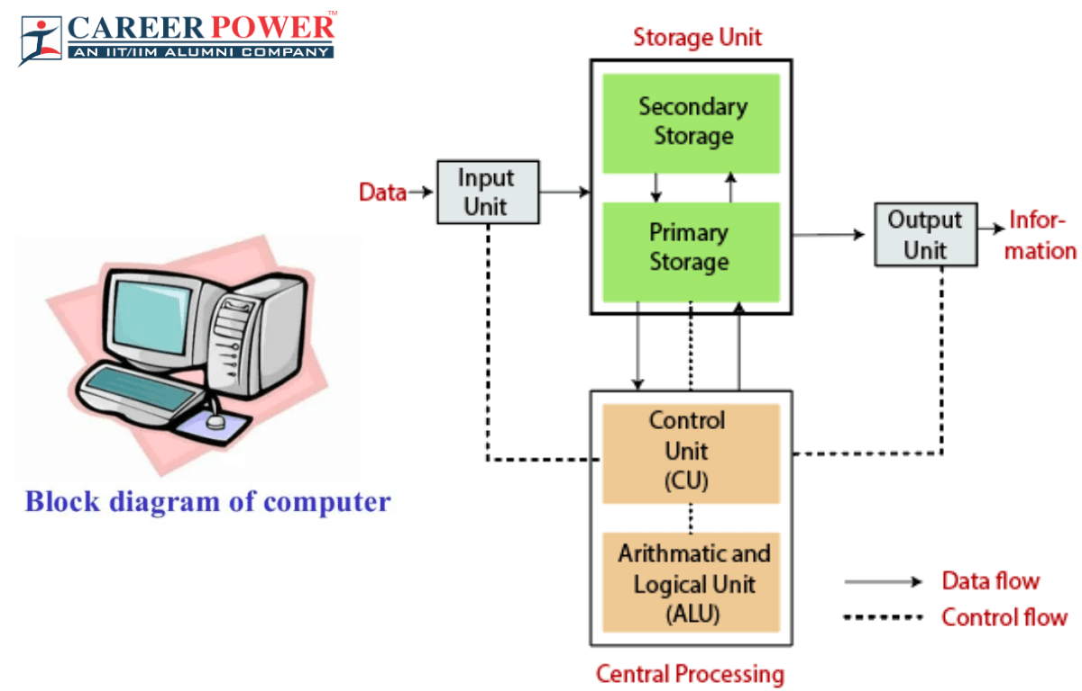
What is a computer?

Slide 8
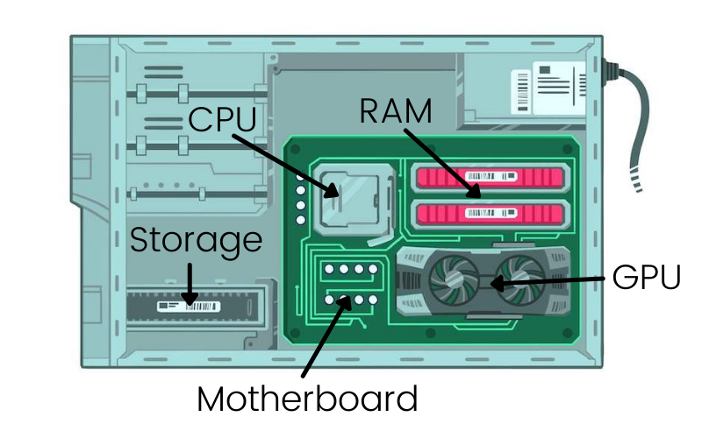
Top things you NEED in a computer
Storage - Hard Drive
RAM – Random Access Memory
CPU – Central Processing Unit
I/O – Input and Output Devices

Slide 9

What is a computer program?
Source code
Human readable
Sequence of instructions for the computer to execute
Translation of our thoughts into operations that the computer understands
Executable
Machine instructions

Slide 10
What is a computer program?
Source code
Human readable
Sequence of instructions for the computer to execute
Translation of our thoughts into operations that the computer understands
This used to be a laborious process, but now we have languages that help us!
Executable
Machine instructions

Slide 11
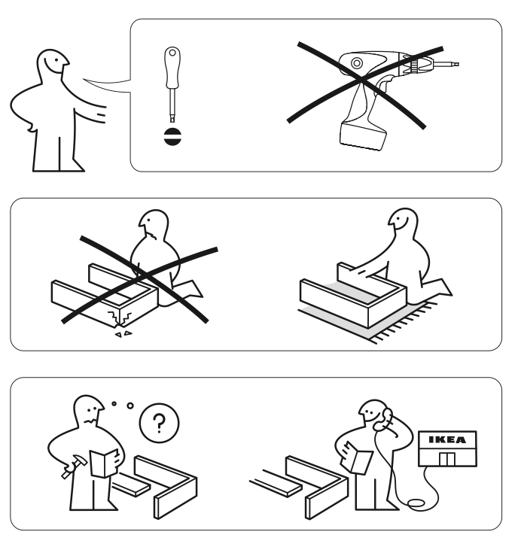

Sequence of instructions
Clear
Concise
Efficient

Slide 12
Sequence of instructions
Computers can’t read your minds!
(yet)
Clear
Concise
Efficient

Slide 13

Repeating instructions
Learn how to do it once
Find the pattern
Repeat it

Slide 14
Pseudocode
A high-level summary of a sequence of instructions
Build twin bed
Repeat
Useful to visualize the order of steps
Serves as the backbone of the code

Slide 15

Algorithms
Precise set of instructions used for solving a problem or performing a task.
Tying your shoes
Finding a book in the library
Following a cooking recipe
Finding the shortest path
Sorting a list of numbers
Recommending digital content

Slide 16
Algorithms
Precise set of instructions used for solving a problem or performing a task.
Tying your shoes
Finding a book in the library
Following a cooking recipe
Finding the shortest path
Sorting a list of numbers
Recommending digital content

Slide 17

Variables
Container to store information
needed in the program
shape = “circle”

Slide 18
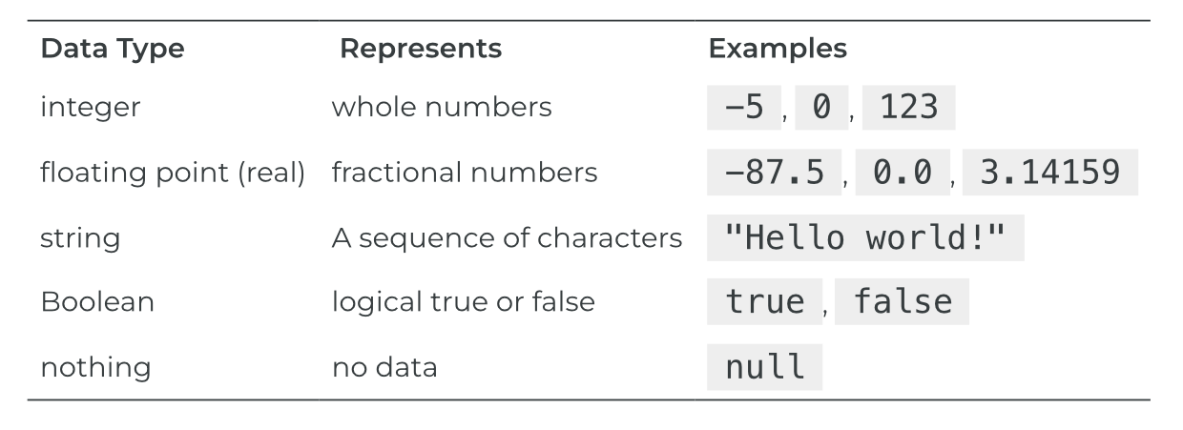



Data types
Refers to the kind of information that can be stored in a variable
TRUE
37
“dog”
Adapted from https://press.rebus.community/programmingfundamentals/chapter/data-types/

Slide 19
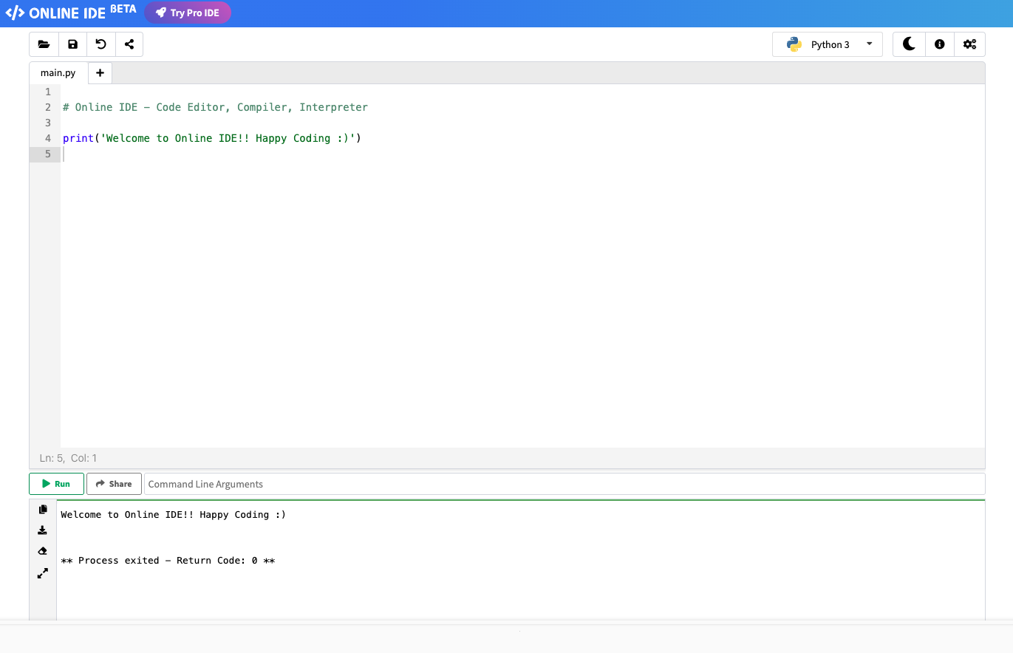
Hands on 1
Exploring Variables!
Today, we will be using an online IDE – Integrated Development Environment
https://www.online-ide.com/online_python_ide
In future workshops, we will show you how to install and use one on your local computer!

Slide 20
This is a comment
A leading # signifies to the IDE not to read this line

Slide 21
This is a comment
A leading # signifies to the IDE not to read this line
This is a print command
It will print any string you give it!
That’s anything in “”

Slide 22
Click on Run!

Slide 23
Click on Run!
We use Return Code as a type of “exit code”
Most times Code 0 means your program worked!

Slide 24
What happens if you remove this parenthesis?

Slide 25
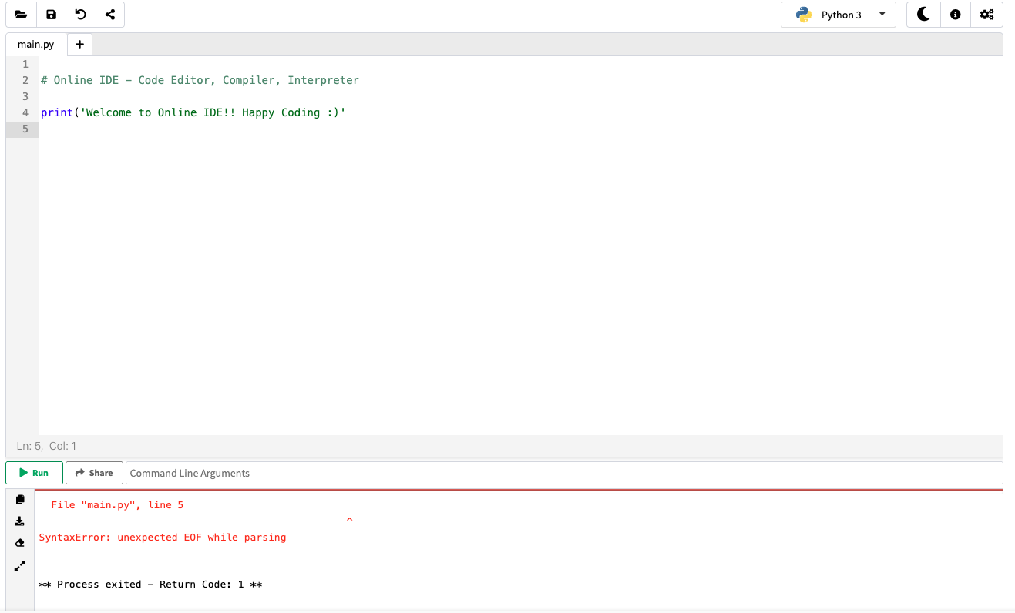
Any guesses?

Slide 27
We got an error! (Don’t panic)

Slide 28
We got an error! (Don’t panic)

Slide 30
EOF means “End of File”

Slide 31
We got a Code of 1!

Slide 32
Before we start!
Python has a “dynamic” typing
It will guess what data type your variable is!

Slide 33
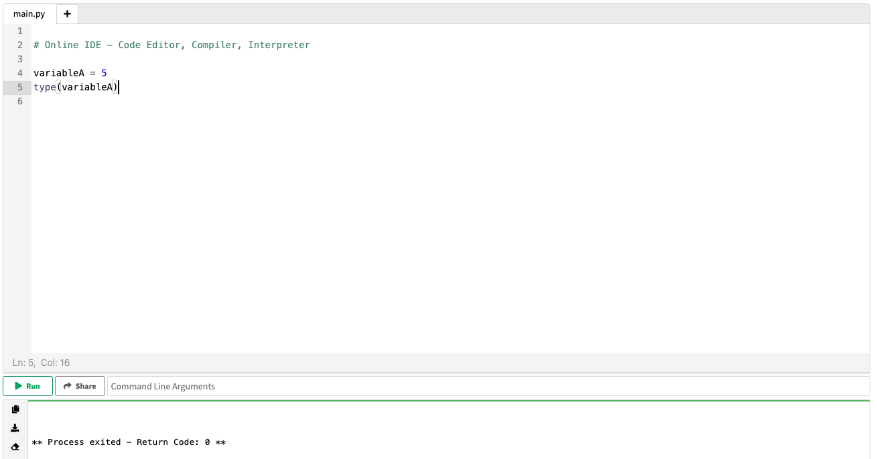
Let’s try it!
We can use the type() command to tell us what the IDE thinks it is!

Slide 34
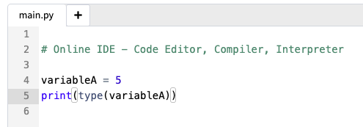
Let’s try it!
We can use the type() function to tell us what the IDE thinks it is!
Use it and the print() function to tell us what variableA is!

Slide 35
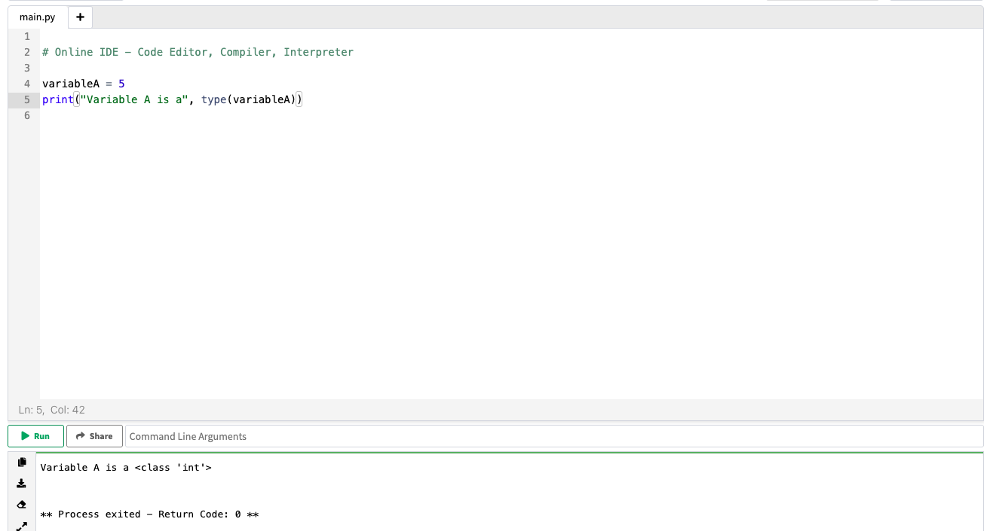
You can even make it “fancy”

Slide 36
Try and assign and print out each variable!
Python uses the keyword None
Python uses the keywords True and False not true and false

Slide 37
Part 2 Coding Fundamentals

Slide 38
Data types
Refers to the kind of information that can be stored in a variable
TRUE
37
“dog”
Adapted from https://press.rebus.community/programmingfundamentals/chapter/data-types/

Slide 39

Boolean logic
A type of operation that can only have two possible outcomes:
TRUE or FALSE
Boolean expression | Result
2+2 == 5 | FALSE
“dog”==“human” | FALSE
2*2 > 1 | TRUE

Slide 40
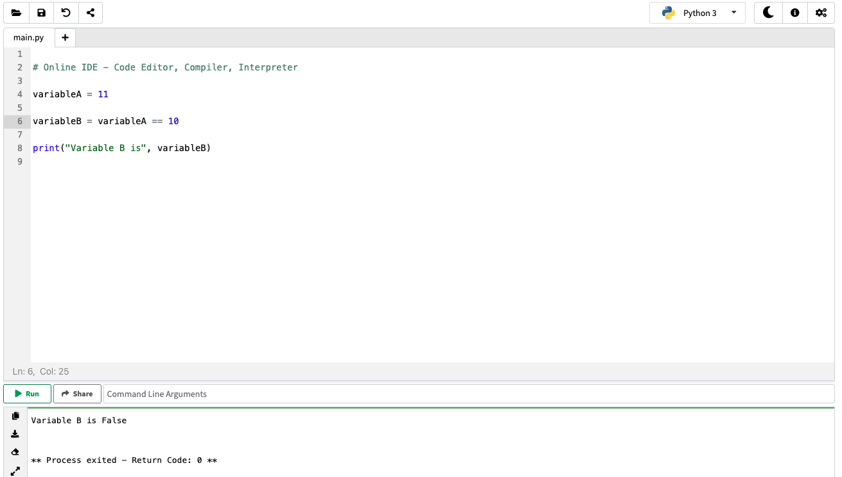
Let’s try it!

Slide 41
Boolean operators
Shape==circle
FALSE
When both expressions are TRUE
TRUE
FALSE
FALSE
AND
FALSE
TRUE
When either one or the other is true
TRUE
OR
FALSE
Checks if the expression if FALSE or not
NOT
FALSE
TRUE

Slide 42
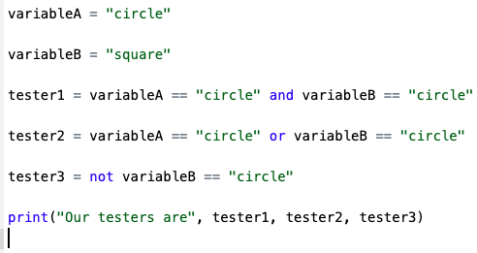

What do these look like in Python?
TRUE
AND
FALSE
FALSE
TRUE
OR
FALSE
NOT
FALSE

Slide 43
We can combine boolean operators!
Shape==circle
NOT
AND
TRUE
FALSE
TRUE
NOT
OR
FALSE

Slide 44
What’s the difference?
Shape==circle
NOT
AND
TRUE
FALSE
TRUE
NOT
OR
FALSE

Slide 45
Let’s try it out in our IDE!
Shape==circle
NOT
AND
TRUE
FALSE
TRUE
NOT
OR
FALSE

Slide 46
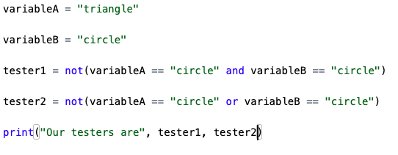
Let’s try it out in our IDE!
Shape==circle
NOT
AND
TRUE
FALSE
TRUE
NOT
OR
FALSE

Slide 47
What’s the difference?
Shape==circle
NOT
AND
TRUE
When both expressions are TRUE
FALSE
TRUE
TRUE
NOT
OR
FALSE
When either one or the other is true
FALSE

Slide 48
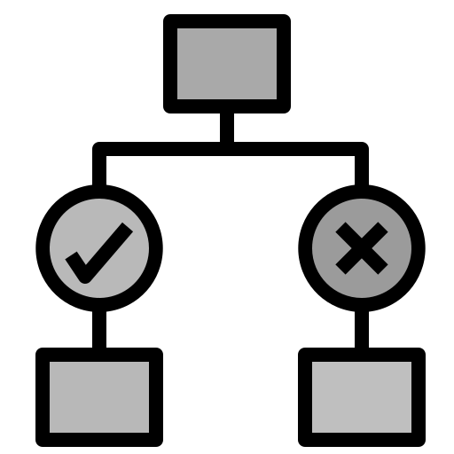
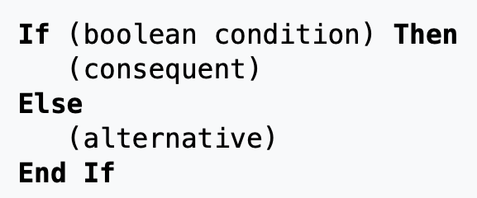
Conditionals
Command used to
make a decision and specify what to do in each case

Slide 49
Conditionals
This is known as an “if statement”: You can even have an “else if” statement For example: Let us have an integer variable that can be:
Positive
Zero
Negative

Slide 50
Pseudocode Example:
Let us have an integer variable that can be:
Positive Zero Negative
Reminder! →

Slide 51
Pseudocode Example:
Let us have an integer variable that can be:
Positive Zero Negative
Reminder! →
If (integer < 0) Then
print(“Negative”)
Else
End If

Slide 52
Pseudocode Example:
Let us have an integer variable that can be:
Positive Zero Negative
Reminder! →
If (integer < 0) Then
print(“Negative”)
Else
End If
If (integer == 0) Then
print(“Zero”)
Else
End If

Slide 53
Pseudocode Example:
Let us have an integer variable that can be:
Positive Zero Negative
Reminder! →
If (integer < 0) Then
print(“Negative”)
Else
End If
If (integer == 0) Then
print(“Zero”)
Else
End If
If (integer > 0) Then
print(“Positive”)
Else
End If

Slide 54
Pseudocode Example:
Let us have an integer variable that can be:
Positive Zero Negative
Reminder! →
If (integer < 0) Then
print(“Negative”)
Else
End If
If (integer == 0) Then
print(“Zero”)
Else
End If
If (integer > 0) Then
print(“Positive”)
Else
End If
This works… but it could be better

Slide 55
Else If (Sometimes called Elif)
Let us have an integer variable that can be:
Positive Zero Negative
If (integer < 0) Then
print(“Negative”)

Slide 56
Else If (Sometimes called Elif)
Let us have an integer variable that can be:
Positive Zero Negative
If (integer < 0) Then
print(“Negative”)
Else If (integer == 0) Then
print(“Zero”)

Slide 57
Else If (Sometimes called Elif)
Let us have an integer variable that can be:
Positive Zero Negative
If (integer < 0) Then
print(“Negative”)
Else If (integer == 0) Then
print(“Zero”)
Else
print(“Positive”)
End If

Slide 58
Else If (Sometimes called Elif)
Let us have an integer variable that can be:
Positive Zero Negative
If (integer < 0) Then
print(“Negative”)
Else If (integer == 0) Then
print(“Zero”)
Else
print(“Positive”)
End If
Two things to keep in mind:
1) Order matters!
2) Sometimes you might want a “catch” statement

Slide 59
Else If (Sometimes called Elif)
Let us have an integer variable that can be:
Positive Zero Negative
If (integer < 0) Then
print(“Negative”)
Else If (integer == 0) Then
print(“Zero”)
Else
print(“Positive”)
End If
Two things to keep in mind:
1) Order matters!
2) Sometimes you might want a “catch” statement

Slide 60
How does order matter?
Let us have an integer variable that can be:
Positive Zero Greater than 9000
If (integer > 0) Then
print(“Positive”)
Else If (integer > 9000) Then
print(“Over 9000!”)
Else
print(“Zero”)
End If
If (integer > 9000) Then
print(“Over 9000!”)
Else If (integer > 0) Then
print(“Positive”)
Else
print(“Zero”)
End If

Slide 61
Else If (Sometimes called Elif)
Let us have an integer variable that can be:
Positive Zero Greater than 9000
If (integer < 0) Then
print(“Negative”)
Else If (integer == 0) Then
print(“Zero”)
Else
print(“Positive”)
End If
Two things to keep in mind:
1) Order matters!
2) Sometimes you might want a “catch” statement

Slide 62
Why do we need a catch statement?
Let us have an integer variable that can be:
Positive Zero Greater than 9000
What happens if we set integer = -1?
If (integer > 9000) Then
print(“Over 9000!”)
Else If (integer > 0) Then
print(“Positive”)
Else
print(“Zero”)
End If

Slide 63
Why do we need a catch statement?
Let us have an integer variable that can be:
Positive Zero Greater than 9000
What happens if we set integer = -1?
If (integer > 9000) Then
print(“Over 9000!”)
Else If (integer > 0) Then
print(“Positive”)
Else If (integer == 0) Then
print(“Zero”)
Else
print(“Error!”)
End If

Slide 64
Why do we need a catch statement?
Let us have an integer variable that can be:
Positive Zero Greater than 9000
What happens if we set integer = -1?
If (integer >= 0) Then Else
print(“Error!) End If
If (integer > 9000) Then
print(“Over 9000!”)
Else If (integer > 0) Then
print(“Positive”)
Else
print(“Zero”)
End If

Slide 65
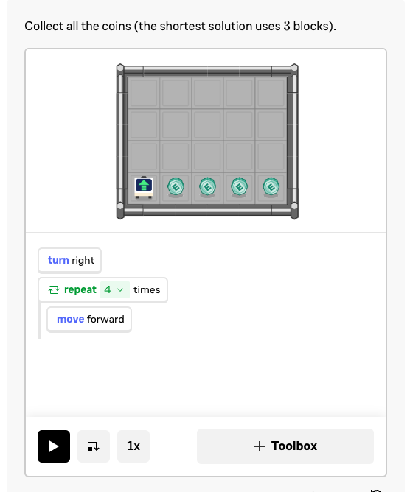
What happens if we combine a conditional with a loop?
While x is true do
(Event)
While (space has ball){
Move forward
End While

Slide 66
While loops can create infinite conditions
While x is > 0 do
x = x – 1
print(x)
End While
While x is > 0 do
x = x + 1
print(x)
End While
3, 2, 1, 0
3, 4, 5, 6, 7, 8, 9, 10, …, 74928403, 74928404, …

Slide 67
While loops can create infinite conditions
While x is > 0 do
x = x – 1
print(x)
End While
While x is > 0 do
x = x + 1
print(x)
End While
3, 2, 1, 0
3, 4, 5, 6, 7, 8, 9, 10, …, 74928403, 74928404, …

Slide 68
While loops can create infinite conditions
While x is > 0 do
x = x – 1
print(x)
End While
While x is > 0 do
x = x + 1
print(x)
End While
Try it yourself! Just be sure to hit the stop button or be ready to lose your webpage!
3, 2, 1, 0
3, 4, 5, 6, 7, 8, 9, 10, …, 74928403, 74928404, …

Slide 69
What if we know we want to do a set of actions but not as a loop

Slide 70
Functions!
Let’s say we want to standardize an array.
In order to do so: subtract the mean from each value and divide by the standard deviation

Slide 71
Functions!
Let’s say we want to standardize an array.
In order to do so: subtract the mean from each value and divide by the standard deviation
How to find the mean?
Take the sum of the array and divide by the length
Or…

Slide 72
Functions!
Let’s say we want to standardize an array.
In order to do so: subtract the mean from each value and divide by the standard deviation
How to find the mean?
Take the sum of the array and divide by the length
Or…
mean(array)

Slide 73
Functions!
Functions allow us to do a series of commands
Instead of writing out
Sum(numbers)/length(numbers)
We just need to write mean(numbers)
Mean is a common function found in most languages or through a library of functions → stats functions can be found in a “statistics” library for example

Slide 74
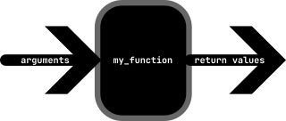
Functions!
Most functions will take some prior information called “arguments”
And will output some return values
You can even make your own functions!

Slide 75
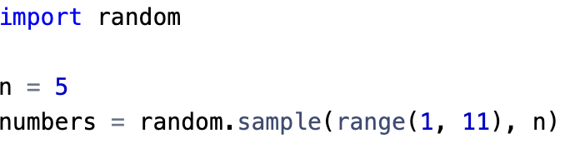
We’re going to try it now!
We’re going to import some packages in Python!
Random
Now let’s find the average!

Slide 76
Commenting
# <- This in general is the symbol for a comment – it tells the program complier to ignore the following message
#The secret number that the user must guess
Secret_number = 10
Sometimes code is hard to read if you don’t know what the coder wants/is doing
Commenting is KEY

Slide 77
Hands On!
Use the Python tab!
Read the comments to learn what the guess should be
Run the program first
Try with an incorrect guess
Then try with the correct guess
Change the secret number
Go to https://codehs.com/ide

Slide 78

Data structures
Specific storage formats designed for efficient data access and management

Slide 79
Lists
This gets tricky depending on the language you use
But in general – let’s say that you have a bunch of variables all involving a single patient
Name
BMI
Age
Sex
Illness status

Slide 80
Lists
Lists work great when you have different variables
Name – String
BMI – Double/Float/Real
Age – Integer
Sex – String or Boolean (How!?!?!)
Illness status – String, Boolean, or Integer?

Slide 81
Arrays/Vectors
Depending on the language of choice, these are change in slight definition/usage
In general:
These only store elements of the same type
If you have 12 patients you can record all of their ages
26, 19, 70, 45, 66, 19, 23, 25, 4, 0, 22, 26

Slide 82
Arrays/Vectors
These are not forced to be just 1 dimensional
Sometimes these are called dataframes:
Rows are individual patients
Columns are different variables: age, sex, illness, etc.

Slide 83
Indexing
numbers = [1,2,3,4]
When you want to grab an element from an array you can type: numbers[i] BUT many programs (like Python) start at position 0 (zero-based indexing)
Notes:
Extension on ide if i == 0:
i = 1
else:
i = 0

Slide 84
Indexing
numbers = [1,2,3,4]
When you want to grab an element from an array you can type: numbers[i] BUT many programs (like Python) start at position 0 (zero-based indexing)
Numbers[1] → 2, not 1
Numbers[0] → 1
Notes:
Extension on ide if i == 0:
i = 1
else:
i = 0

Slide 85
Final Hands-On (if time permits)
On the IDE from https://codehs.com/ide
Turn my_number into an array with more than 1 element
(Hint: the syntax you use is my_number = [x,y,z])
Change the while statement to check for a new variable my_number[i]
Using an if else statement, have i change for the index

Slide 86
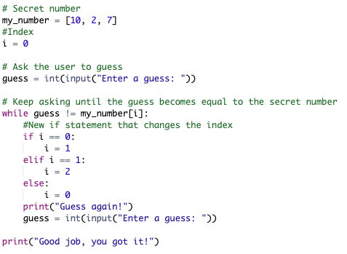
This is my solution

Slide 87




But before coding…
Understand the problem
Recognize patterns
Think about the solution
Write a pseudocode

Slide 88
Make it work Make it right Make it fast
Kent Beck

Slide 89




What are the major steps for any program?

Slide 90
What are the major steps for any program?
Input – Data in
Execution – Data processing
Output – Data out

Slide 91
In summary
Practice structured thinking
Become familiar with programming logic
Learn about basic programming components
Now you are ready to:
Learn a specific programming language
Perform data analysis
Learn about machine learning
Write programs that generate visualizations

Slide 92
https://www.mcgill.ca/micm/training/workshops-series

Slide 93
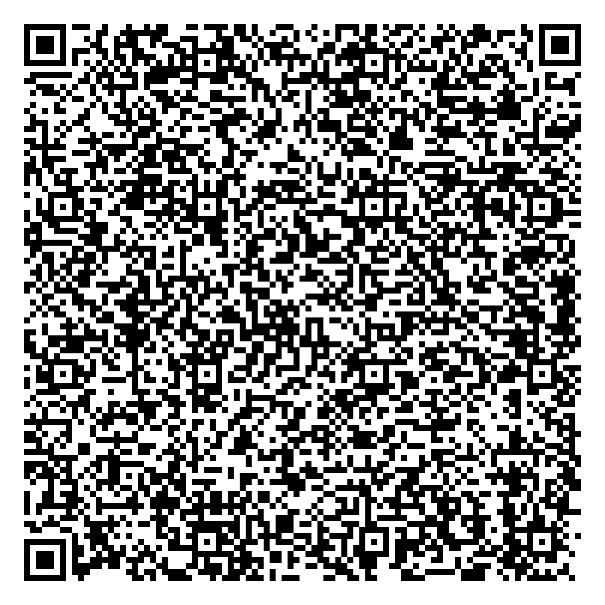


Thank you for attending!
1
2
3
Scan the QR code to confirm you attended today’s workshop.
Fill out the feedback survey in the next 72h.
Get recognition for this workshop on your
co-curricular record.

Slide 94
Thank you for attending!
1
2
3
Scan the QR code to confirm you attended today’s workshop.
Fill out the feedback survey in the next 72h.
Get recognition for this workshop on your
co-curricular record.

